Slide 1
GRAPHS THEORY
Session 17-20
Course : Z0184-Discrete Mathematics
Effective Period : September 2017

Slide 2
These slides have been adapted from:
Susanna S.Epp. (2010). Discrete Mathematics with Applications.4th edition. Thomson Brooks/Cole. USA. ISBN: 9780534359454
Chapter 11
Acknowledgement

Slide 3
On successful completion of this Course, students will be able to:
Learning Objectives
LO 1: Explain the logic of compound and quantified statements and how do to proof
LO 2: Explain and applying Set Theory, Counting method and Number Theory
LO 3: Explain Function, recursion, fuzzy set, Relations and Graph Theory
LO 4: Explain Trees & Graph theory and its application
LO 5: Explain Automata and graph its application in computer science

Slide 4
Graphs
The whole of mathematics consists in the organization of a series of aids to the
imagination in the process of reasoning.
— Alfred North Whitehead, 1861–1947

Slide 5
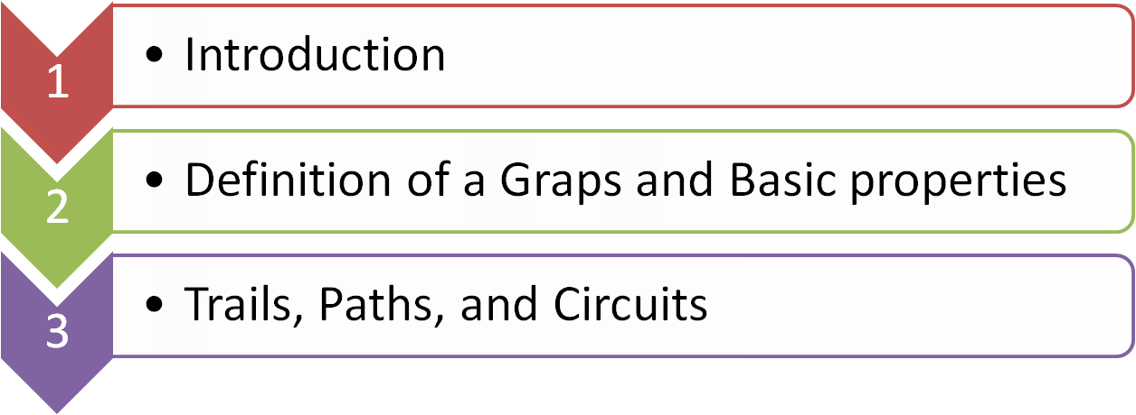


Outline
Matrix Representations of Graphs
Isomorphism and Coloring Graph

Slide 6
INTRODUCTION

Slide 7
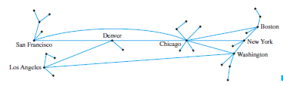
Uses of Graph
Computer networks, the Internet, and telephone, electric power, gas pipeline, and air transport systems can all be represented by graphs.
Questions that arise in the design of such systems involve choosing connecting edges to minimize cost, optimize a certain type of service, and so forth. A typical communication system is shown below

Slide 8
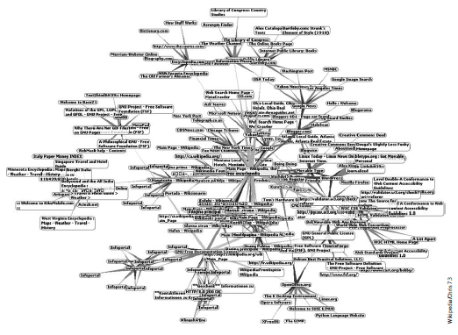
Uses of Graph
Using a Graph to Represent the World Wide Web :
The picture below shows a minute fraction of the hyperlink connections on the Internetthat radiate in and out from the Wikipedia main page.

Slide 9
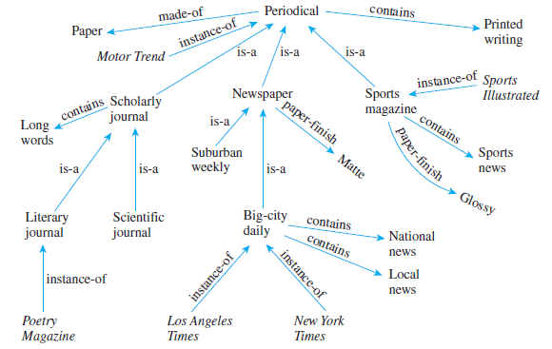
Uses of Graph
Using a Graph to Represent Knowledge :
The directed graph shown below is a pictorial representation for a simplified knowledge base about periodical publications.

Slide 10
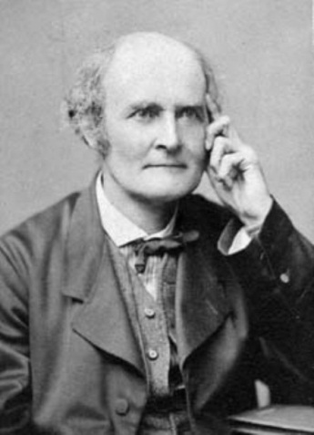
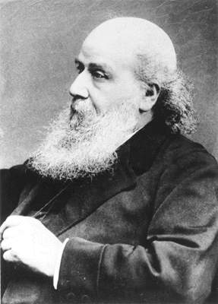
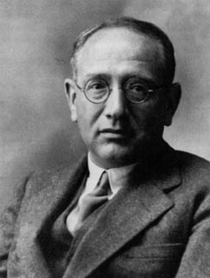
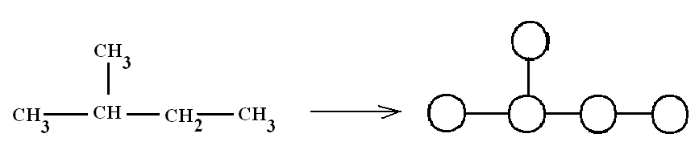
Uses of Graph
Using a Graph to Enumeration of Chemical Isomers
Arthur Cayley James J. Sylvester George Polya

Slide 11
DEFINITION OF A GRAPS AND BASIC PROPERTIES

Slide 12
Definition of a Graph
A graph G consists of two finite sets: a nonempty set V(G) of vertices and a set E(G) of edges, where each edge is associated with a set consisting of either one or two vertices called its endpoints.
The correspondence from edges to endpoints is called the edge-endpoint function.

Slide 13
Definition (Cont’d)
An edge with just one endpoint is called a loop, and two or more distinct edges with the same set of endpoints are said to be parallel. An edge is said to connect its endpoints; two vertices that are connected by an edge are called adjacent; and a vertex that is an endpoint of a loop is said to be adjacent to itself.
An edge is said to be incident on each of its endpoints, and two edges incident on the same endpoint are called adjacent. A vertex on which no edges are incident is called isolated.

Slide 14
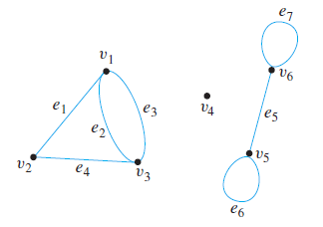
Example :Terminology
Consider the following graph
a. Write the vertex set and the edge set, and give a table showing the edge-endpointfunction.
b. Find all edges that are incident
on v1, all vertices that are adjacent
to v1, all edges that are adjacent
to e1, all loops, all parallel edges,
all vertices that are adjacent to
themselves, and all isolated vertices.

Slide 15
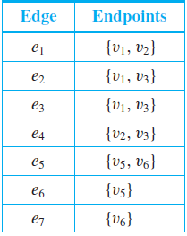
Terminology
Solution (a):
vertex set = {v1, v2, v3, v4, v5, v6}
edge set = {e1, e2, e3, e4, e5, e6, e7}
edge-endpoint function:
Note that the isolated vertex v4 does
not appear in this table. Although each
edge must have either one or two
endpoints, a vertex need not be an endpoint of an edge.

Slide 16
Terminology
Solution (b) :
e1, e2, and e3 are incident on v1.
v2 and v3 are adjacent to v1.
e2, e3, and e4 are adjacent to e1.
e6 and e7 are loops.
e2 and e3 are parallel.
v5 and v6 are adjacent to themselves.
v4 is an isolated vertex.

Slide 17
Simple Graphs
Definition
A simple graph is a graph that does not have any loops or parallel edges.
In a simple graph, an edge with endpoints v and w is denoted {v, w}.

Slide 18
Complete Graphs - K_{n}
Definition
A simple graph is complete if every pair of distinct vertices share an edge.
The notation K_{n} denotes the complete graph on n vertices.
K₁ K₂ K₃ K₄ K₅

Slide 19
Bipartite Graph
V1
V2
A bipartite graph
is an undirected graph
G = (V,E) in which V can be partitioned into 2 sets V1 and V2 such that ( u,v) ∈ E implies either
u ∈ V1 and v ∈ V2
OR
v ∈ V1 and u ∈ V2.
u₁
v₁
u₂
v₂
u₃
v₃
u₄

Slide 20
Complete Bipartite - K_{m,n}
Definition
When all possible edges exist in a simple bipartite graph with m red vertices and n green vertices, the graph is called complete bipartite and the notation K_{m,n} is used.
K_{2,3} K_{4,5}

Slide 21
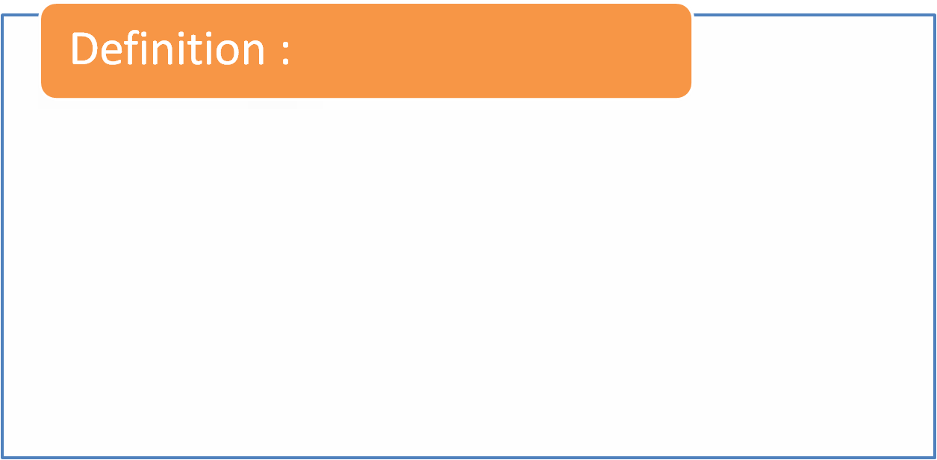
A Directed Graph
A directed graph, or digraph, consists of two finite sets: a nonempty set V(G) of vertices and a set D(G) of directed edges, where each is associated with an ordered pair of vertices called its endpoints. If edge e is associated with the pair (v,w) of vertices, then e is said to be the (directed) edge from v to w.

Slide 22
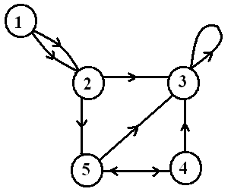
Digraphs
Definition
A directed graph (or digraph) G = (V,E ) consists of a non-empty set V of vertices (or nodes) and a set E of edges with E ⊆V ×V.
The edge (a,b) is also denoted by
a →b and a is called the source
of the edge while b is called
the target of the edge.
loop
multiple arc
node
arc

Slide 23
Subgraphs
Notice that the 2-cube occurs
inside the 3-cube .
In other words, Q₂ is a subgraph of Q₃ :
Definition
Let G = (V,E ) and H = (W,F ) be graphs. H is said to be a subgraph of G, if W ⊆ V and F ⊆ E.

Slide 24
Degree
Definition
The degree of a vertex counts the number of edges that seem to be sticking out if you looked under a magnifying glass:
Thus deg(2) = 7 even though 2 only incident with 5 edges
e₆
e₁
magnify
1
e₂
2
e₅
e₃
e₄
3

Slide 25
Weighted Graph
A weighted graph is a graph for which each edge has an associated weight, usually given by a weight function
w: E → R
2
2
1.2
0.5
4
2
6
1
0.2
3
3
1
9
2.1
8
4
4

Slide 26
Handshaking Theorem
If G is any graph, then the sum of the degrees of all the vertices of G equals twice the number of edges of G.
Specifically, if the vertices of G are v₁, v₂, …. , v_{n}, where n is a nonnegative integer, then
The total degree of G = deg(v₁) + deg(v₂) +….+ deg(v_{n})
= 2(the number of edges of G).

Slide 27
Example:
Handshaking Theorem
e₁
e₆
1
e₂
2
e₅
e₃
e₄
e₇
3
4
There are two ways to count the number of edges in the above graph:
Just count the set of edges: 7
Using Handshaking Theorem:
(deg(1)+deg(2)+deg(3)+deg(4))/2 = (3+7+2+2)/2 = 7

Slide 28
TRAILS, PATHS, AND CIRCUITS

Slide 29
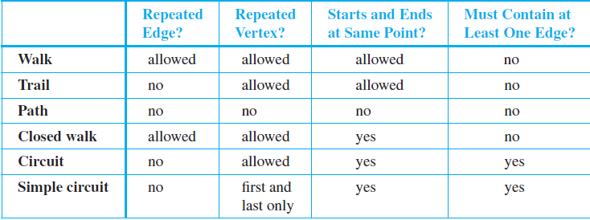
Definition

Slide 30
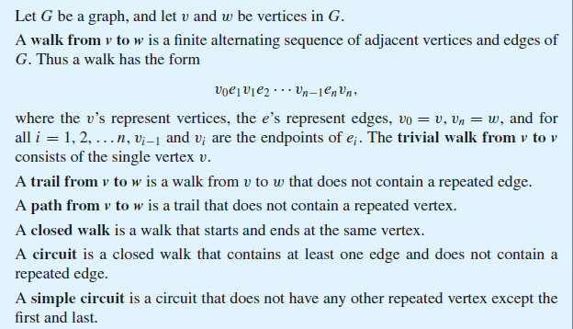
Definitions : Walk

Slide 31
Walk
EG: could get from 1 to 3 circuitously as follows:
1-e₁→2-e₁→1-e₃→3-e₄→2-e₆→2-e₅→2-e₄→3
e₆
e₁
1
e₂
2
e₃
e₅
e₄
e₇
3
4

Slide 32
Walk
EG: could get from 1 to 3 circuitously as follows:
1-e₁→2-e₁→1-e₃→3-e₄→2-e₆→2-e₅→2-e₄→3
e₆
e₁
1
e₂
2
e₃
e₅
e₄
e₇
3
4

Slide 33
Walk
EG: could get from 1 to 3 circuitously as follows:
1-e₁→2-e₁→1-e₃→3-e₄→2-e₆→2-e₅→2-e₄→3
e₆
e₁
1
e₂
2
e₃
e₅
e₄
e₇
3
4

Slide 34
Walk
EG: could get from 1 to 3 circuitously as follows:
1-e₁→2-e₁→1-e₃→3-e₄→2-e₆→2-e₅→2-e₄→3
e₆
e₁
1
e₂
2
e₃
e₅
e₄
e₇
3
4

Slide 35
Walk
EG: could get from 1 to 3 circuitously as follows:
1-e₁→2-e₁→1-e₃→3-e₄→2-e₆→2-e₅→2-e₄→3
e₆
e₁
1
e₂
2
e₃
e₅
e₄
e₇
3
4

Slide 36
Walk
EG: could get from 1 to 3 circuitously as follows:
1-e₁→2-e₁→1-e₃→3-e₄→2-e₆→2-e₅→2-e₄→3
e₆
e₁
1
e₂
2
e₃
e₅
e₄
e₇
3
4

Slide 37
Walk
EG: could get from 1 to 3 circuitously as follows:
1-e₁→2-e₁→1-e₃→3-e₄→2-e₆→2-e₅→2-e₄→3
e₆
e₁
1
e₂
2
e₃
e₅
e₄
e₇
3
4

Slide 38
Walk
EG: could get from 1 to 3 circuitously as follows:
1-e₁→2-e₁→1-e₃→3-e₄→2-e₆→2-e₅→2-e₄→3
e₆
e₁
1
e₂
2
e₃
e₅
e₄
e₇
3
4

Slide 39
Walk
EG: could get from 1 to 3 circuitously as follows:
1-e₁→2-e₁→1-e₃→3-e₄→2-e₆→2-e₅→2-e₄→3
e₆
e₁
1
e₂
2
e₃
e₅
e₄
e₇
3
4

Slide 40
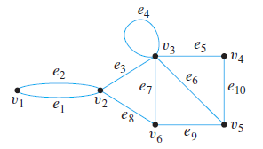
Example
In the graph below, determine which of the following walks are trails, paths, circuits, or
simple circuits.
V1e1v2e3v3e4v3e5v4 b. e1e3e5e5e6
V2v3v4v5v3v6v2 d. v2v3v4v5v6v2 e. v1e1v2e1v1
f. v1

Slide 41
Solution
a. This walk has a repeated vertex but does not have a repeated edge, so it is a trail from v1 to v4 but not a path.
b. This is just a walk from v1 to v5. It is not a trail because it has a repeated edge.
c. This walk starts and ends at v2, contains at least one edge, and does not have a repeated edge, so it is a circuit. Since the vertex v3 is repeated in the middle, it is not a simple circuit.
d. This walk starts and ends at v2, contains at least one edge, does not have a repeated edge, and does not have a repeated vertex. Thus it is a simple circuit.

Slide 42
Solution (cont’d)
e. This is just a closed walk starting and ending at v1. It is not a circuit because edge e1 is repeated.
f. The first vertex of this walk is the same as its last vertex, but it does not contain an edge, and so it is not a circuit. It is a closed walk from v1 to v1. (It is also a trail from
v1 to v1.)

Slide 43
Connected and Disconnected
Graph
An undirected graph is connected if you can get from any node to any other by following a sequence of edges OR any two nodes are connected by a path
Connected Graph Disconnected Graph
Bina Nusantara University

Slide 44
Euler Circuits
Definition
Let G be a graph. An Euler circuit for G is a circuit that contains every vertex and every edge of G.
That is, an Euler circuit for G is a sequence of adjacent vertices and edges in G that has at least one edge, starts and ends at the same vertex, uses every vertex of G at least once, and uses every edge of G exactly once.
Theorem
A graph G has an Euler circuit if, and only if, G is connected and every vertex of G has even degree

Slide 45
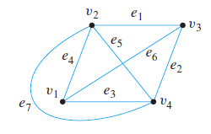
Finding an Euler Circuit
Example 1 : Show that the graph below does not have an Euler circuit.
Solution :
Vertices v1 and v3 both have degree 3, which is odd, this graph does not have an Euler circuit.

Slide 46
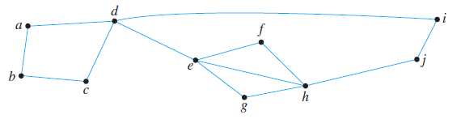
Finding an Euler Circuit
Example 2 : check that the graph below has an Euler circuit

Slide 47
Finding an Euler Circuit
Solution :
deg(a) = deg(b) = deg(c) = deg( f ) = deg(g) = deg(i )
= deg( j ) = 2 and that deg(d) = deg(e) = deg(h) = 4.
Hence all vertices have even degree. Also, the graph is connected. Thus, by Theorem , the graph has an Euler circuit.

Slide 48
Euler Path
Definition
An Euler path from vertex v to w is a sequence of adjacent edges and vertices that starts at v, ends at w, passes through every vertex of G at least once, and traverses every edge of G exactly once.
Theorem
Let G be a graph, and let v and w be two distinct vertices of G. There is an Euler path from v to w if, and only if, G is connected, v and w have odd degree, and all other vertices of G have even degree.

Slide 49
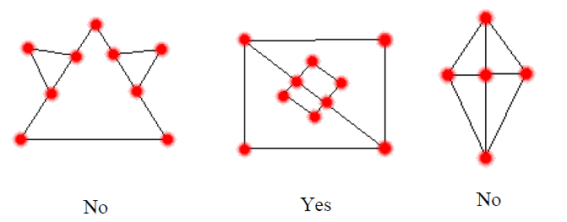
Example: Euler Path (1/2)
Do the graph below have Euler paths?

Slide 50
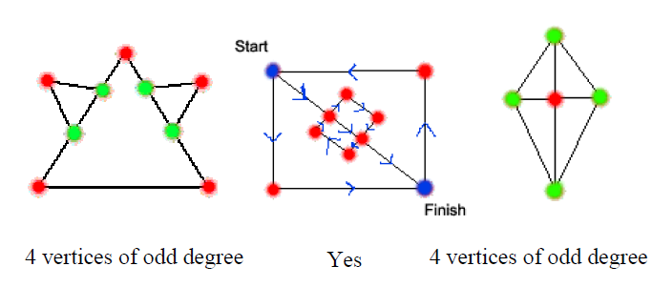
Example: Euler Path (2/2)
Do the graph below have Euler paths?

Slide 51
Example: Euler Path
We can find an Euler Path on the following graph
1
2
3
start
finish
4
6
5

Slide 52
Hamiltonian Circuit and Path
Definition
A Hamiltonian circuit for G is a simple circuit that includes every vertex of G.
A Hamilton path in a graph G is a path which visits ever vertex in G exactly once.
Bina Nusantara University

Slide 53
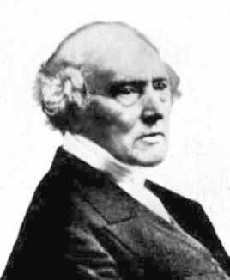
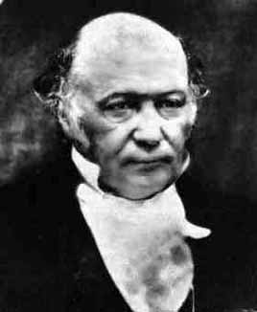
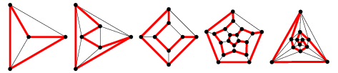
Hamiltonian- History
Cycles in Polyhedra
Thomas P. Kirkman William R. Hamilton
Hamiltonian cycles in Platonic graphs

Slide 54
Planar Graphs
Definition
Planar graphs are graphs that can be drawn in the plane without edges having to cross

Slide 55
MATRIX REPRESENTATIONS OF GRAPHS

Slide 56
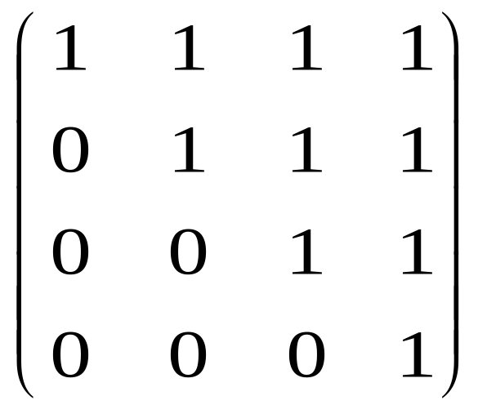
The Adjacency Matrix
for Digraphs
Definition
Let G be a directed graph with ordered vertices v₁,v₂, ...,v_{n}. The adjacency matrix of G is the matrix A = (a_{ij}) over the set of nonnegative integers such that
a_{ij} = the number of arrows from v_{i} to v_{j} for all i, j = 1,2,..., n.
2
1
3
4

Slide 57
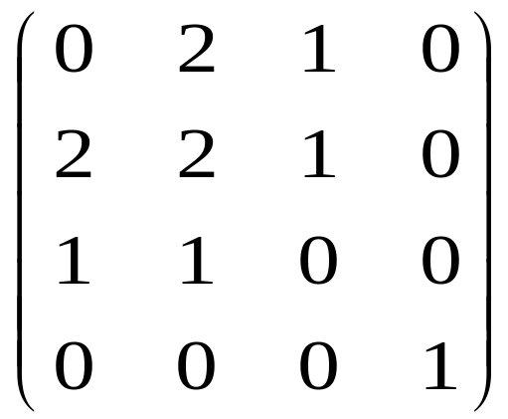
The Adjacency Matrix for
Undirected Graphs
Definition
Let G be a directed graph with ordered vertices v₁,v₂, ...,v_{n}. The adjacency matrix of G is the matrix A = (a_{ij}) over the set of nonnegative integers such that
a_{ij} = the number of arrows from v_{i} to v_{j} for all i, j = 1,2,..., n.
1
2
3
4

Slide 58
ISOMORPHISM AND COLORING GRAPH

Slide 59
Isomorphisms of Graphs
Definition
Two graphs are isomorphic if can bend, stretch and reposition vertices of the first graph, until the second graph is formed. Etymologically, isomorphic means “same shape”.

Slide 60
Properties of Isomorphism
Isomorphic graphs have the same:
Number of vertices and edges
Degrees at corresponding vertices
Types of possible subgraphs
Any other property defined in terms of the basic graph theoretic building blocks!

Slide 61
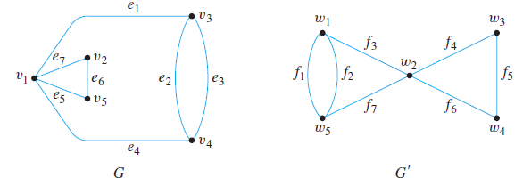
Isomorphisms of Graphs
Example :
Show that the following two graphs are isomorphic

Slide 62
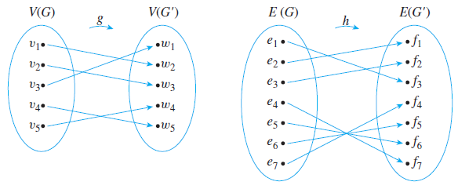
Isomorphisms of Graphs
Solution :
We can find functions g and h to define the isomorphism between G and G’. One pair of functions (there are several) is the following:

Slide 63
Vertex Coloring
Definition
Let n be a positive number. A simple graph is n -colorable if the vertices can be colored using n colors so that no two adjacent vertices have the same color.
The chromatic number (χ) of a graph is smallest number n for which it is n -colorable.
.

Slide 64
Vertex Coloring
The chromatic number for
C_{n} = 3 (n is odd) or 2 (n is even),
K_{n} = n,
K_{m,n} = 2
Theorem : Any planar graph is 4-colorable
C₄
C₅
K₄
K_{2, 3}

Slide 65
Welch-Powell Algorithm
Step1.
Order the vertices of G in decreasing degree. (Such an ordering may not be unique since some vertices may have the same degree.)
Step 2.
Use one color to paint the first vertex and to paint, in sequential order, each vertex on the list that is not adjacent to a vertex previously painted with this color.
Step 3.
Start again at the top of the list and repeat the process painting previously unpainted vertices using a second color.
Step 4.
Continue repeating with additional colors until all the vertices have been painted.

Slide 66
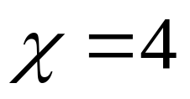
Example 1
V1
V2
V3
V5
V4
Simpul | V1 | V4 | V5 | V6 | V2 | V3 | V7
Derajat | 5 | 4 | 4 | 4 | 3 | 3 | 3
Warna | a | b | c | d | b | c | a
V6
V7

Slide 67
Example 2
V1
V3
V2
V4
V5
V6
Simpul | V1 | V6 | V2 | V3 | V4 | V5
Derajat | 4 | 4 | 3 | 3 | 3 | 3
Warna | a | a | b | b | c | c

Slide 68
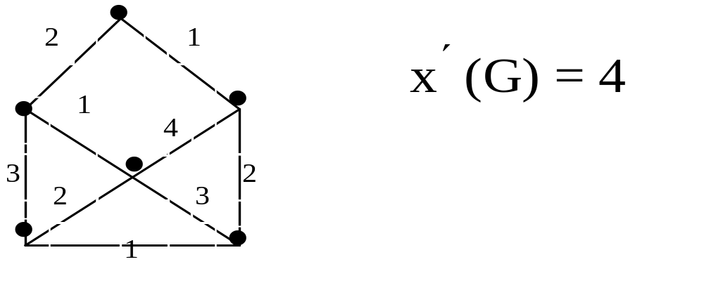
Edge Coloring
Definition
Edge coloring (χ’) is using n colors (n is the smallest number) so that no incident edge have the same color.

Slide 69
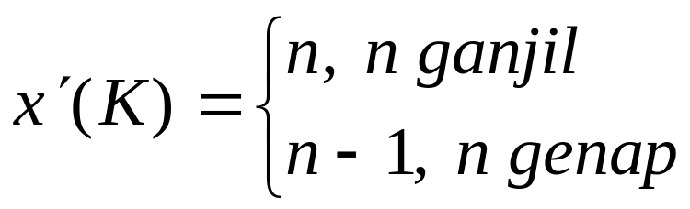
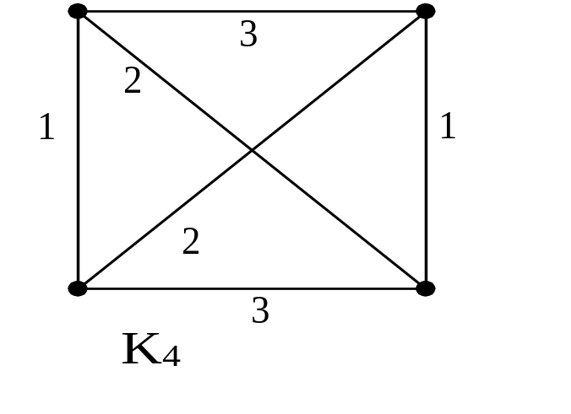
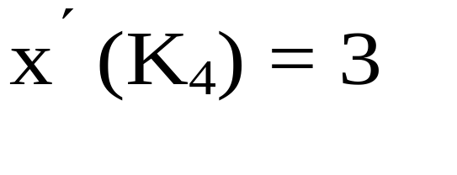
Edge Coloring For Kn

Slide 70
Reference
Susanna S.Epp. (2015). Discrete Mathematics with Applications.5th edition. Thomson Brooks/Cole. USA. ISBN: 9780534359454

